Slide 1
Inter-Tribal Council of Michigan
2021 UP Mobile Mammography Event
Notes:
The Inter-Tribal Council of Michigan, Inc. (ITCM) is a 501©(3) non-profit corporation duly organized under a State Charter filed April 16, 1968. The Inter-Tribal Council of Michigan, Inc. is located in Sault Ste. Marie, Michigan. It represents twelve federally recognized tribes in Michigan.
Mission Statement
To act as a forum for member tribes
To advocate for member tribes in the development of programs and policies which will improve the economy, education, and quality of life for Michigan’s Native Americans; and
To provide technical assistance to member tribes, assisting in the development of tribal regulations, ordinances, and policies applicable to health and human services.

Slide 2
Increasing Health Equity in Rural Tribal Communities
The partnership with Spectrum Health Betty Ford Breast Services, the Inter-Tribal Council of Michigan and the Hannahville and Bay Mills Indian Communities began in 2019.
The number of women served has increased by more than 30% since 2019
BC3NP enrollments and Medicaid screenings increased by more than 30% since 2019
Breast cancer screening rates have increased by more than 20% since 2019 at the Hannahville and Bay Mills Indian Communities
Successfully changed Michigan Medicaid policy from a limit of 1 screening mammogram annually (or every 366 days), to 1 screening mammogram per year with no annual limits.

Slide 3
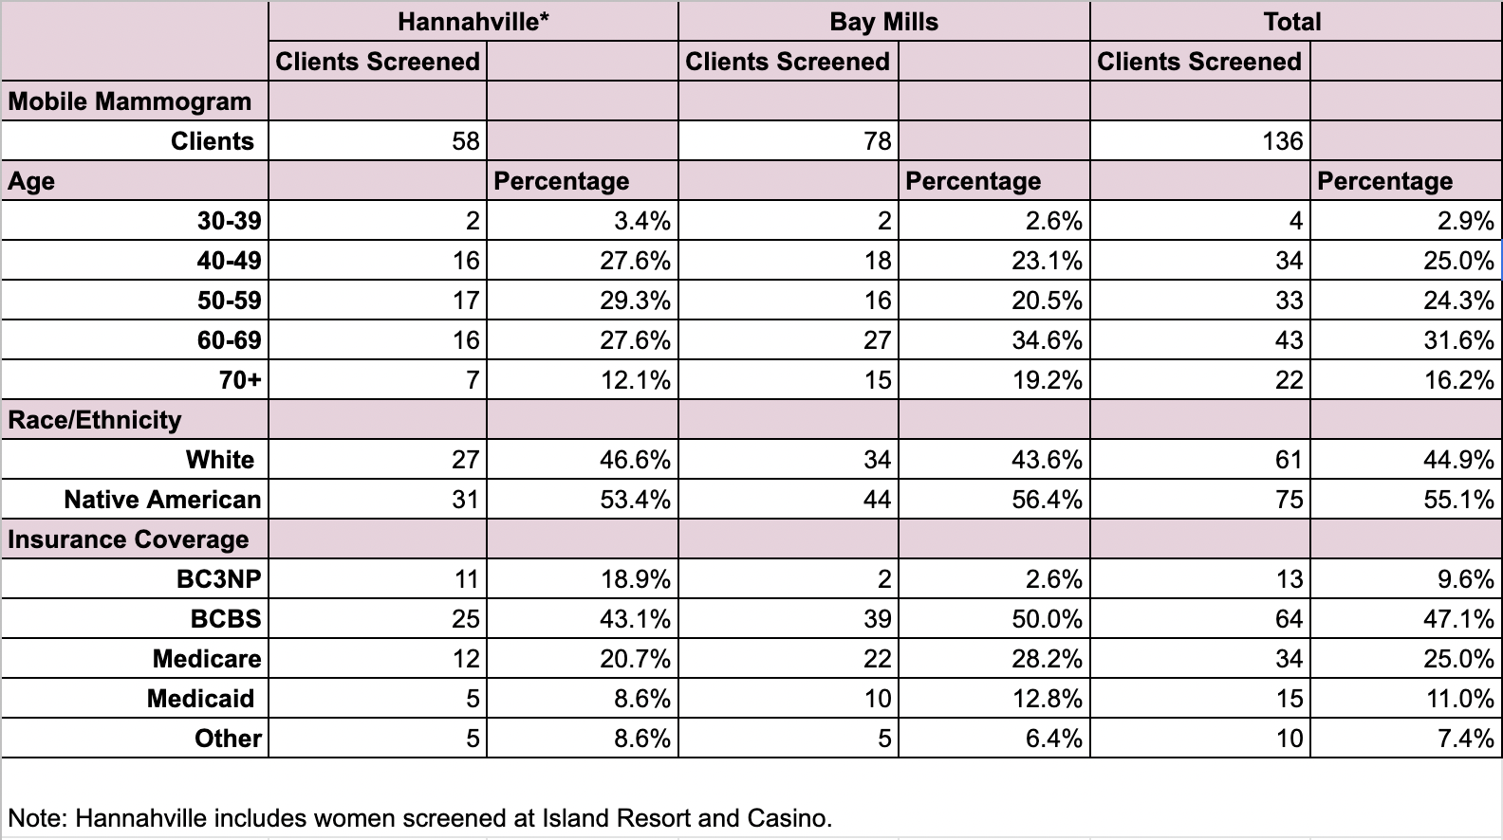
Demographics of Rural and Native American Women
136 women screened over a period of 5-Days
51% of Women were ages 39 - 60 years
55% of Women screened were
Native American
28 % of Women at Hannahville site were
BC3NP/Medicaid Enrollees
Notes:
As a result of these low screening rates, AI/AN women are diagnosed with breast cancer at later stages of the disease and have poorer disease outcomes [23]. Five-year breast cancer survival rates for AI/AN women are among the lowest of all racial/ethnic groups. Several factors have been identified or suggested as reasons for late stage diagnosis of breast cancer, including low compliance to breast cancer screening, less education, socio-economic factors (poverty, lack of access to healthcare, lack of healthcare insurance), cultural considerations, and institutional factors.
Also, there may be a generational divide in the way that AI women perceive breast cancer and breast cancer screening. Women from an older generation perceived screening mammography as embarrassin
Filippi, Melissa K et al. “Breast cancer screening perceptions among American Indian women under age 40.” Journal of cancer education : the official journal of the American Association for Cancer Education vol. 28,3 (2013): 535-40. doi:10.1007/s13187-013-0499-4

Slide 4
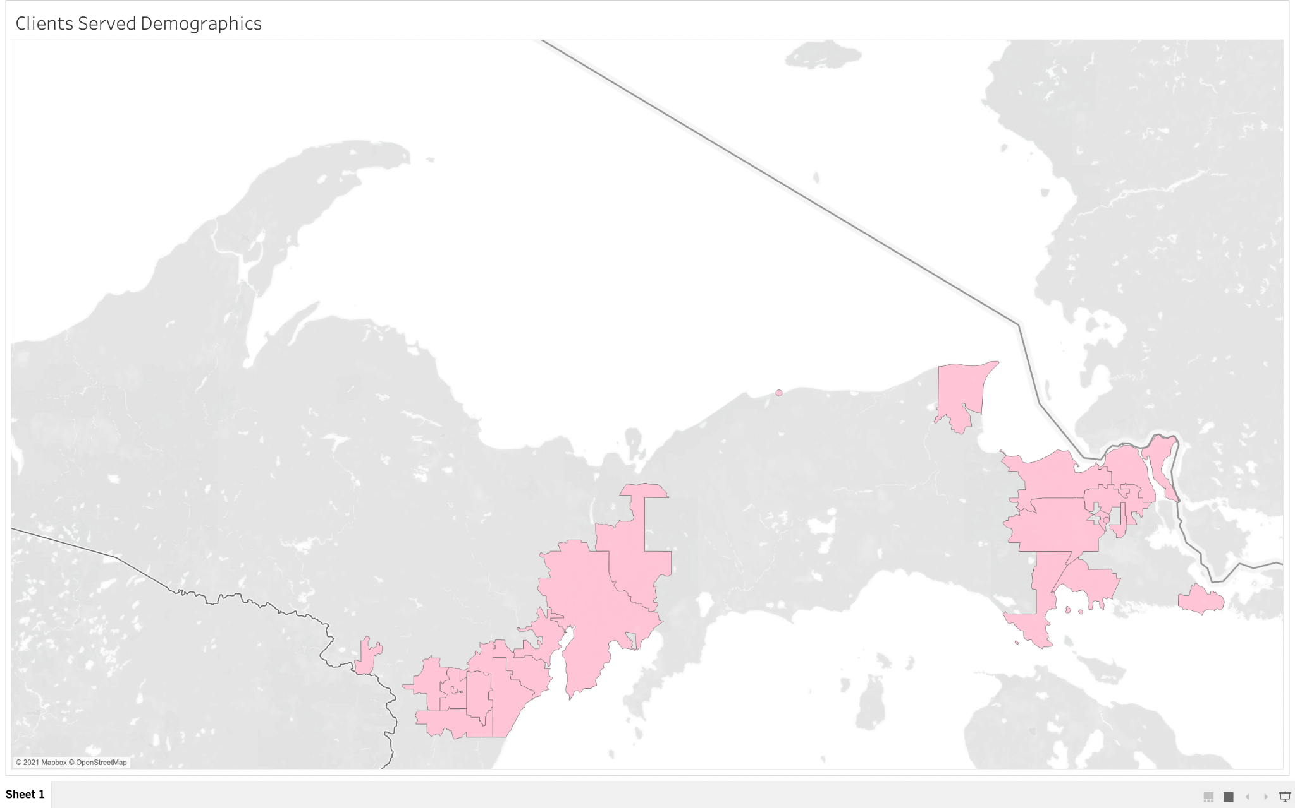
2021 Upper Peninsula Screening/Media Coverage Area
Clients represent 25 Zip Codes across the Upper Peninsula
Media outreach represents identified client reached
Mass Media
WJMN
WWTV/WWUP
5 Newspapers
288 Miles
Small Media
Lufts Advertiser
398 Miles
Spectrum Betty Ford Breast Services
Notes:
TV Interviews:
WJMN-TV Local 3 – Marquette - Kelly Hansen
WWTV/WWUP-TV 9&10 News – Traverse City/Sault Ste. Marie - Betty Jahnke
Radio:
WSOO – AM1230 Radio Soo Morning Show -
Newspapers:
Paid Ad: Luft Shopper
Press Releases picked up with:
Escanaba Daily Press, Hannahville Tribal Newspaper
The Sault News, Sault Tribe Newspaper, Bay Mills Newspaper
Press Release also delivered to WBUP ABC 10 – Marquette, WPBN/WTOM TV 7&4 Traverse City/Sault Ste. Marie, WGTU/WGTQ ABC 29&8 Traverse City/Sault Ste. Marie, Eagle Media Radio (KBIC’s Radio Station Group)
Lufts - ½ page ad 6000 households Hannahville/Escanaba circulation area $120.27 August - September
Facebook - 3,143 Women age 40 - 65 August 15 - September 15 $100

Slide 5
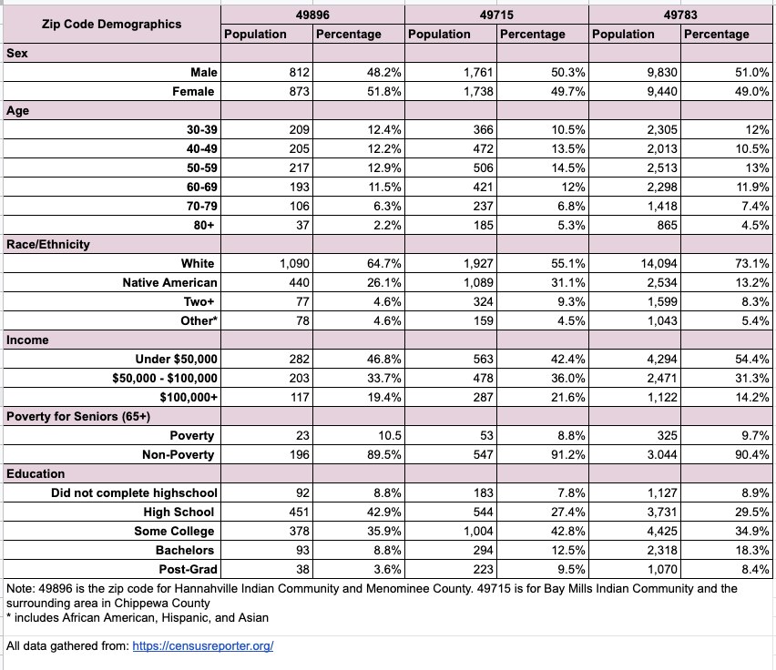
Demographics of Top 3 Zip Codes of Clients Screened
American Indians make up roughly 25% of the population
55% of women identified as AI
An average of 47.9% of the population make under $50,000 a year
25% of women screened qualified for Medicaid and BC3NP
Research has shown that less educated women are substantially less likely to receive a screening mammography

Slide 6
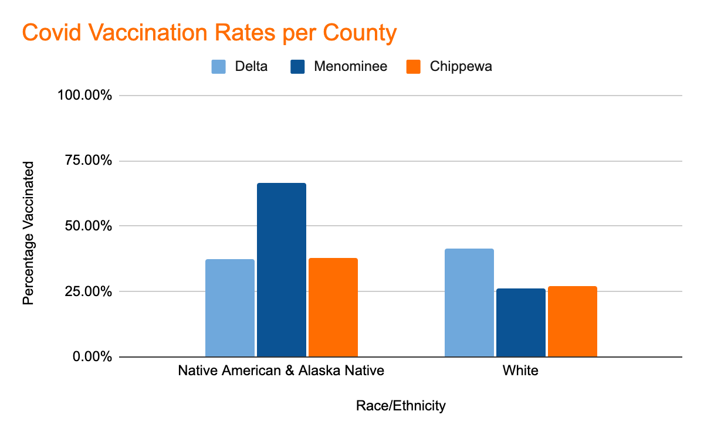
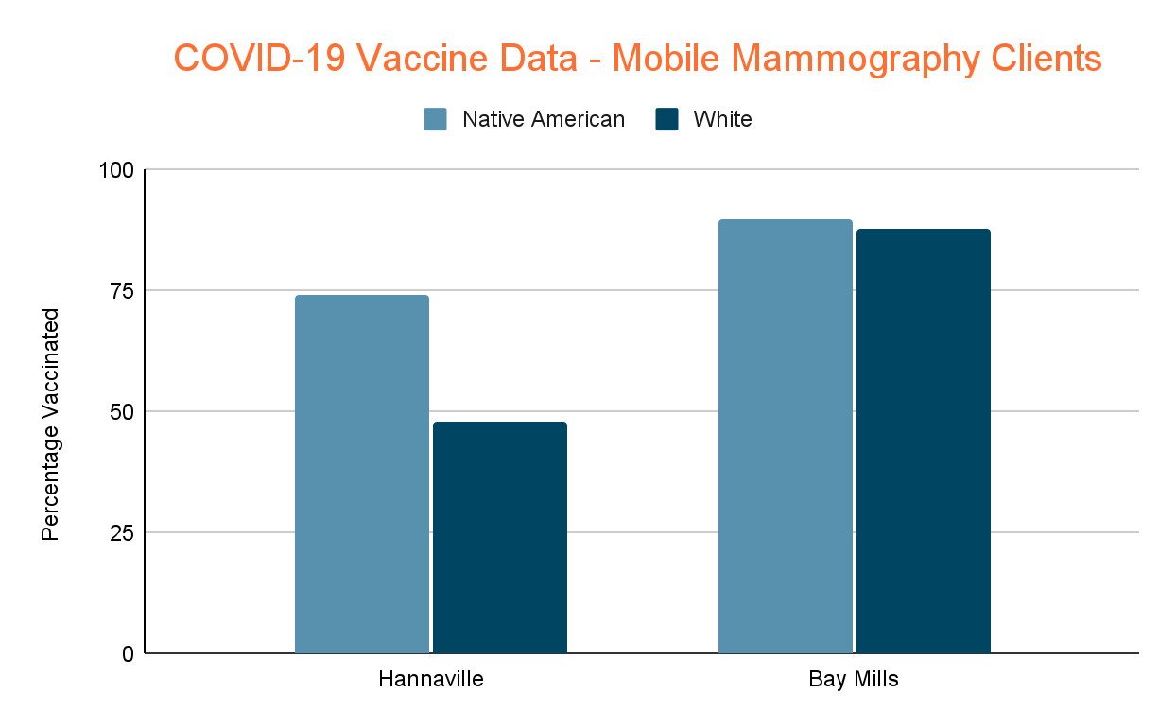
Mobile Mammogram - COVID-19 Vaccinations
Similar trends can be seen between vaccination rates per county and those who were vaccinated at the screening events.
Native Americans have the highest Covid vaccination rates in the United States.
Notes:
Should we say something about vaccination rates? These callouts restate what is already there? Maybe something about high vaccination rates in tribal communities? Just a thought.
https://www.michigan.gov/coronavirus/0,9753,7-406-98178_103214-547150--,00.html

Slide 7
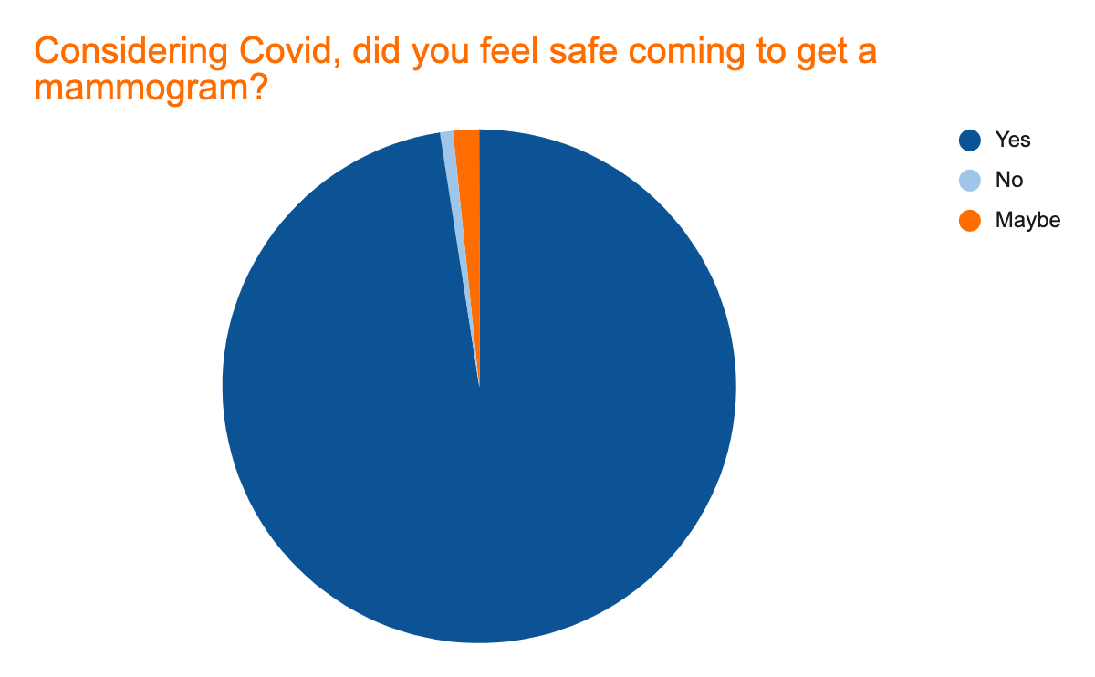
Exit Survey Responses
The ITCM and Spectrum Health developed an infection prevention protocol for mobile screenings in tribal communities
97.5% of clients felt safe being screening in the mobile unit
76% of clients screened were vaccinated for COVID-19
Notes:
We need the actual charts in the slides.

Slide 8
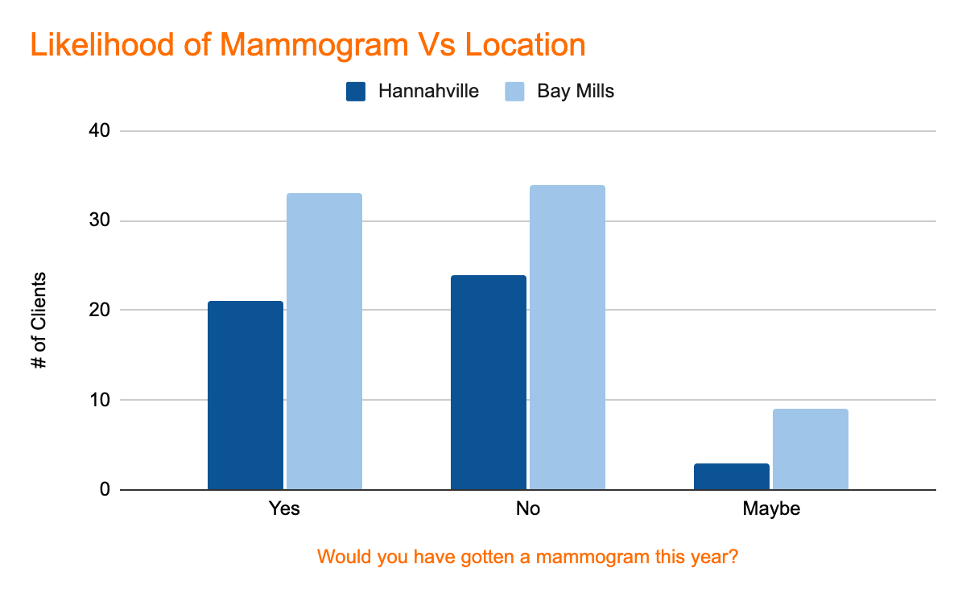
Exit Survey Responses
Question: Would you have gotten a Mammogram this year if the Mobile Mammogram unit was not available?
A total of 43.5% would and 48% would not
Bay Mills Site: 43.6% no
Hannahville Site: 41.4% no

Slide 9
Screening Results and Follow-up
Breast Imaging-Reporting and Data System assessment (BI-RADS) categories (0 - 7)
There are 7 categories of BI-RADS
BI-RADS 1 and 2 (Benign Findings) Results Normal
BI-RADS 0 Incomplete assessment needs additional evaluation
BI-RADS 3 - 7 Assigned after additional evaluations
Navigation for BI-RADS 0 patients is the responsibility of tribal clinics and BC3NP coordinator
Notification for BI-RADS 1 patients completed by Spectrum Health
Notes:
Hacking, C., Bell, D. Breast imaging-reporting and data system (BI-RADS) assessment category 0. Reference article, Radiopaedia.org. (accessed on 25 Oct 2021) https://doi.org/10.53347/rID-40110
Utilized when digital imaging is incomplete in cases such as:
further imaging/ information is required
previous images unavailable at time of reading
Mammograms with suspicious findings are generally assigned BI-RADS 0
Indicate a need for callback/recall for diagnostic evaluation

Slide 10
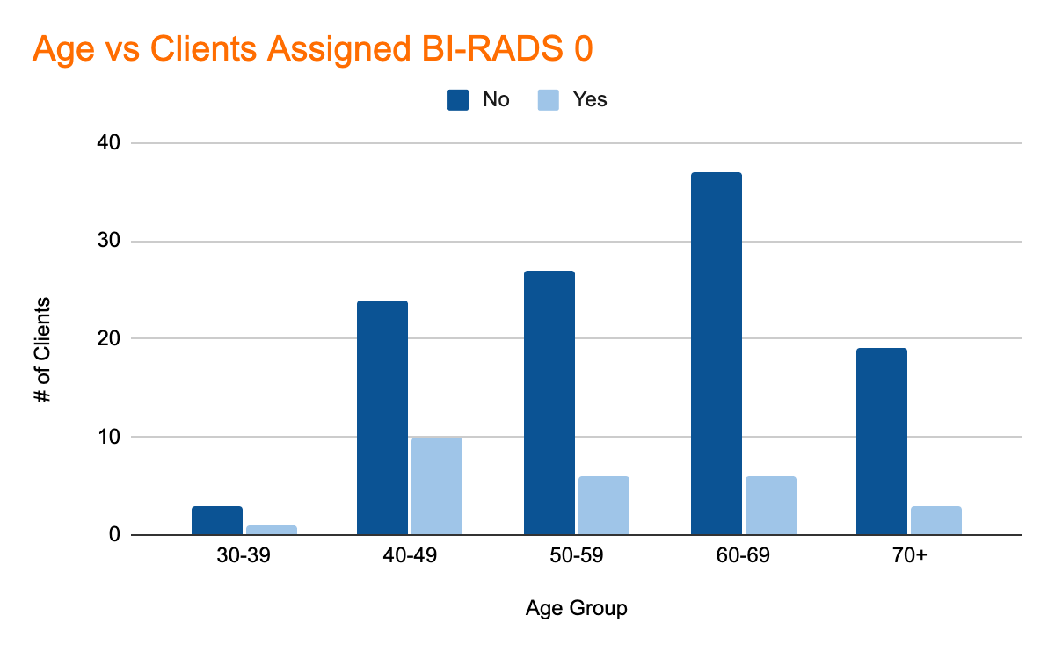
Clients Assigned BI-RADS 0 - Based on Age
Total of 26 women were assigned BI-RADS 0
Women between the ages of 40-49 had the highest numbers of additional imaging needed
29.4% of women between the ages of 40-49 needed additional imaging

Slide 11
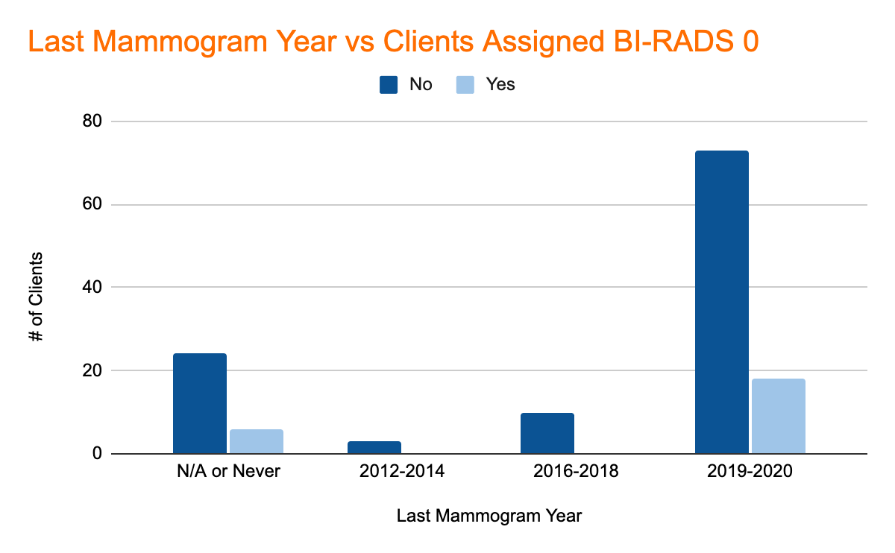
Clients Assigned BI-RADS 0 - Based on Last Mammogram
No women required additional screening for those who had last mammogram between 2012-2018
30 women completed their 1st mammogram during this event
25% of women who had their 1st mammogram were assigned BI-RADS 0
116% increase from 2020

Slide 12
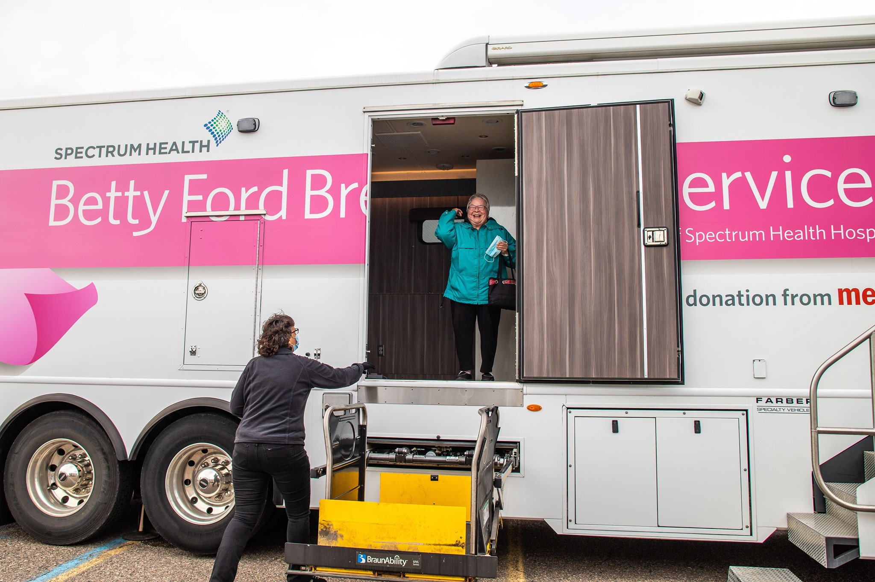
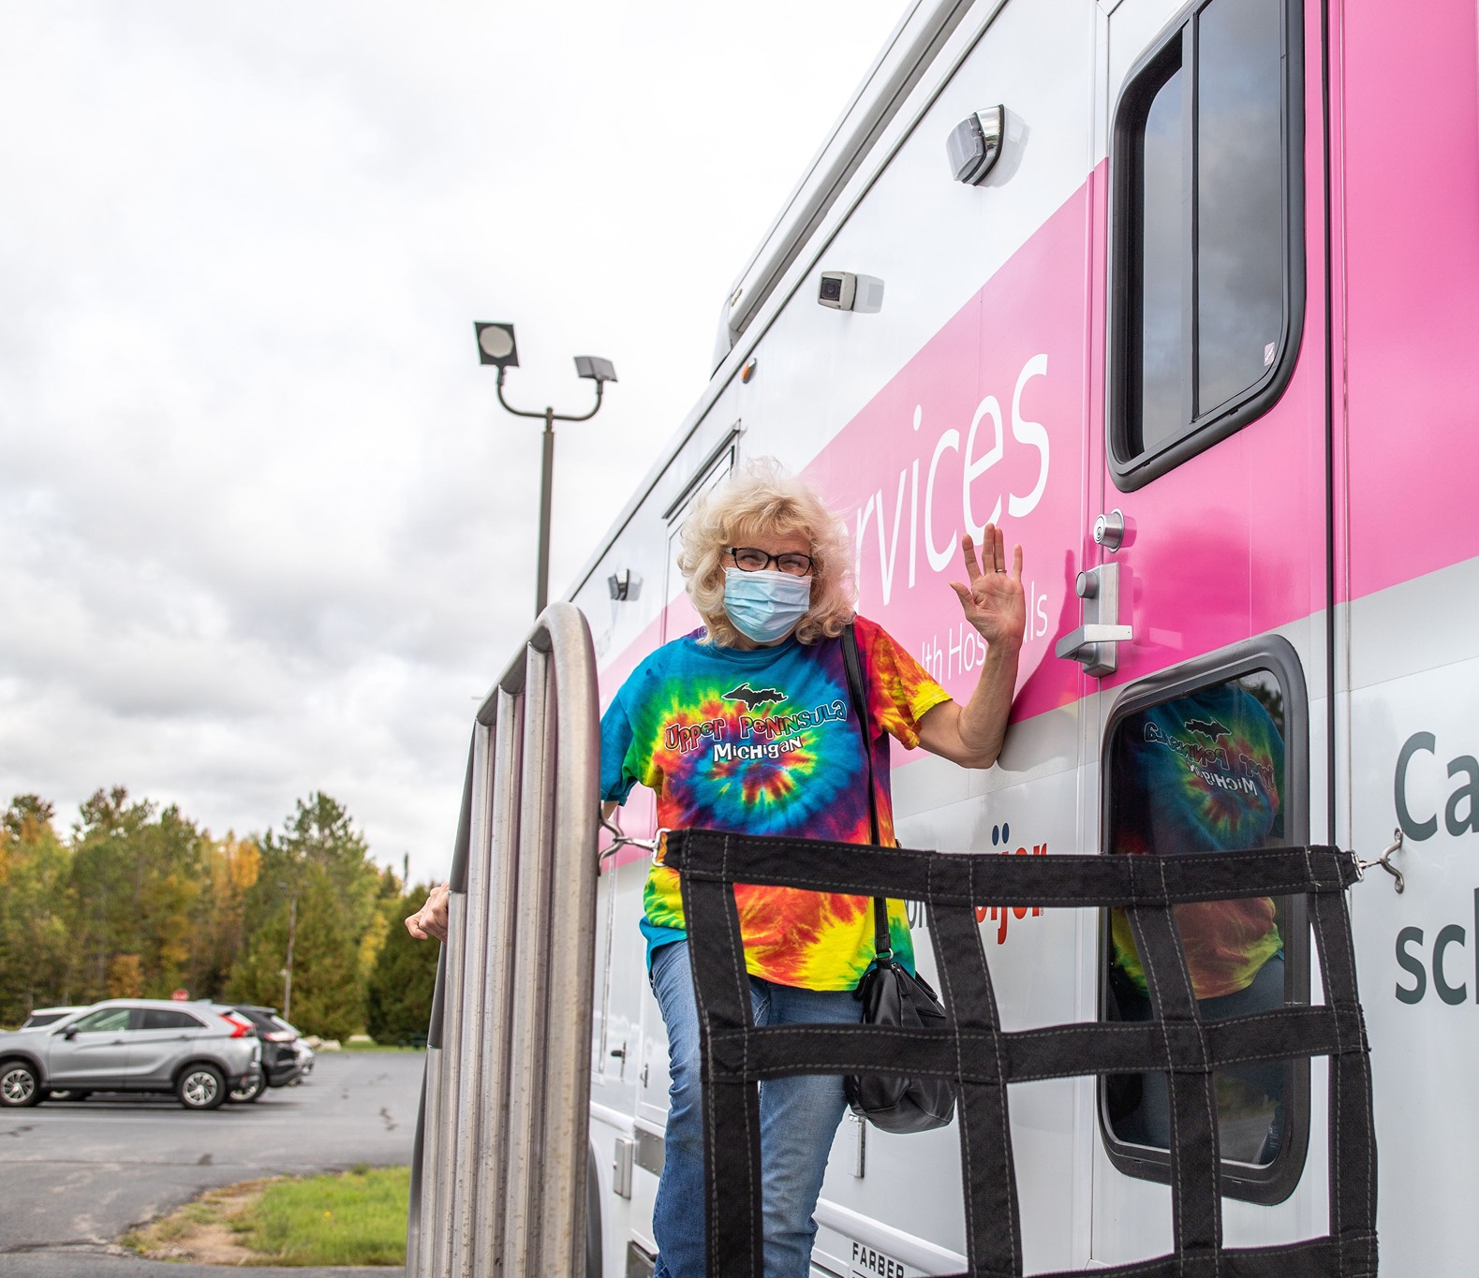
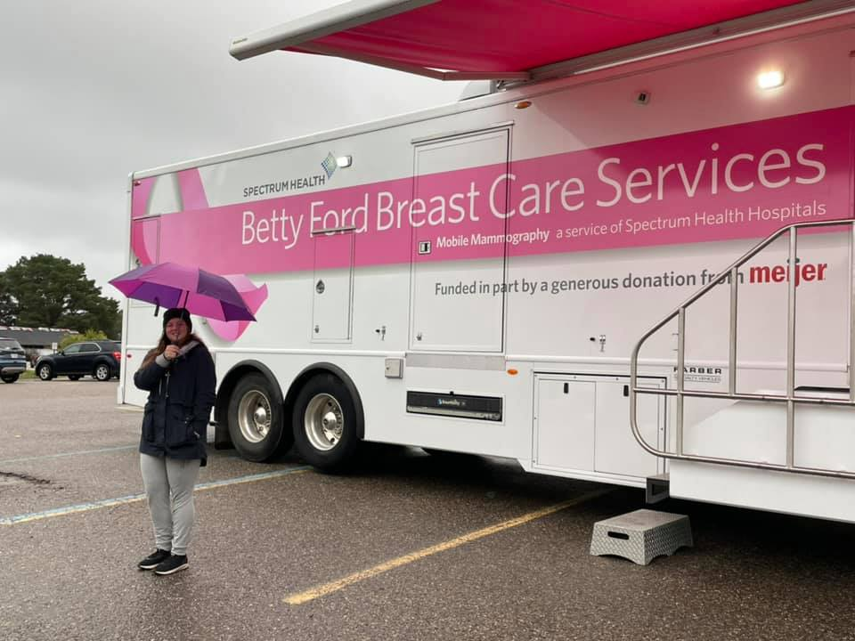
Thoughts About the Screening?
Great. Convenient. I have a hard time getting out so this was good for me.
I probably would have got my screening, but it would have been a hassle taking off work and driving all the way into town, I work at the school and this made it so convenient to do.
Really good, everyone was really nice. I hope you are here next year
Comfortable it’s nice to know what’s going on with my health and especially doing it right here on the reservation.

Slide 13
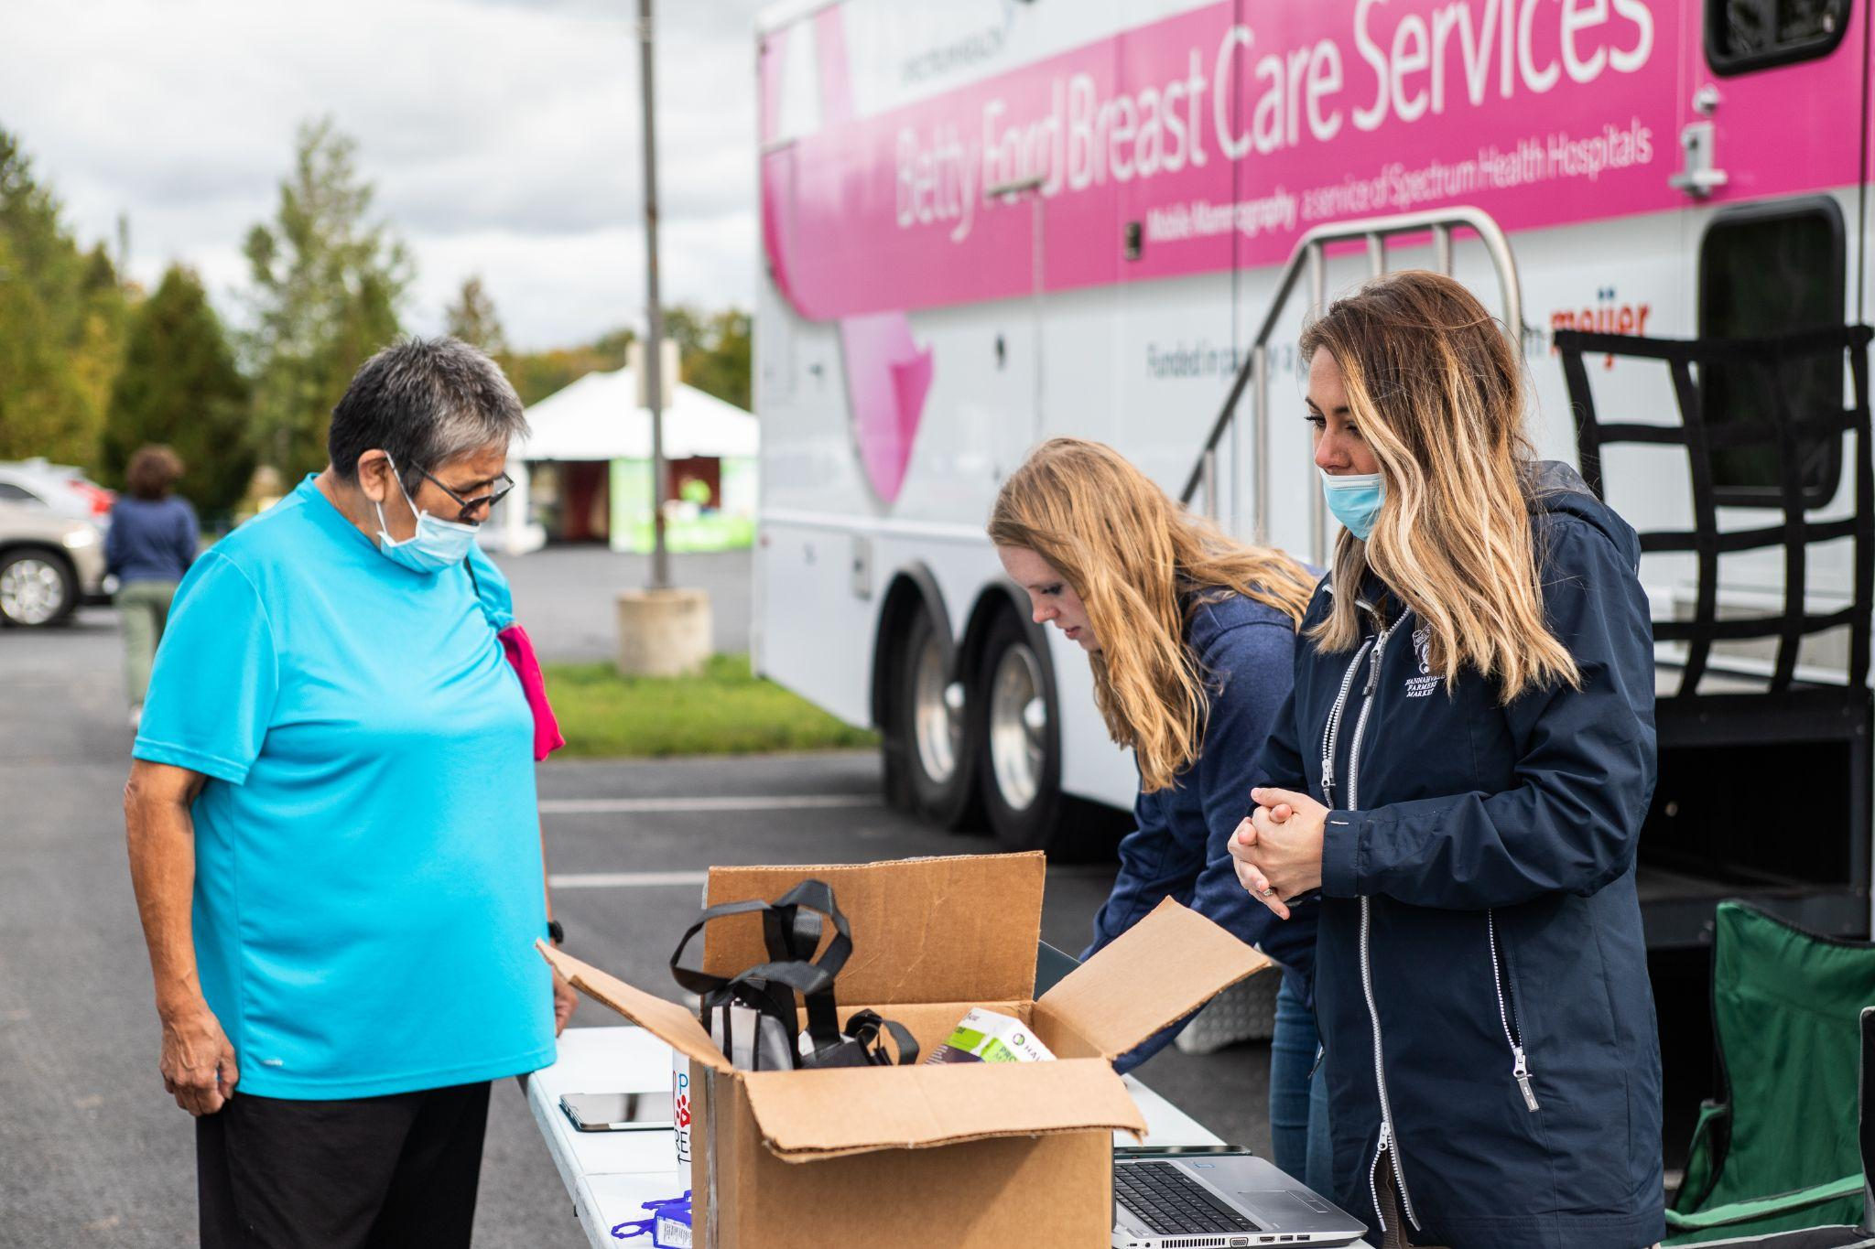
Questions or Comments

Slide 14
Where to Find Us
@InterTribalCouncilMichigan
@KweBrave
@intertribalcouncilmichigan
@kwebrave
https://www.itcmi.org/
E-mail: info@itcmi.org

Slide 15
Back-Up Slides

