Slide 1
Michigan Health Equity Data Project
2018 Update
Health Disparities Reduction and Minority Health Section, Michigan Department of Health and Human Services

Slide 2
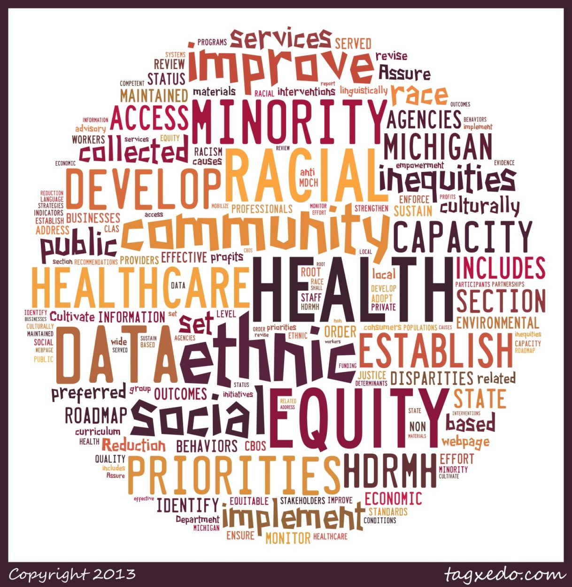
Michigan Health Equity Roadmap Recommendations 1-5
Michigan Health Equity Roadmap, MDHHS

Slide 3
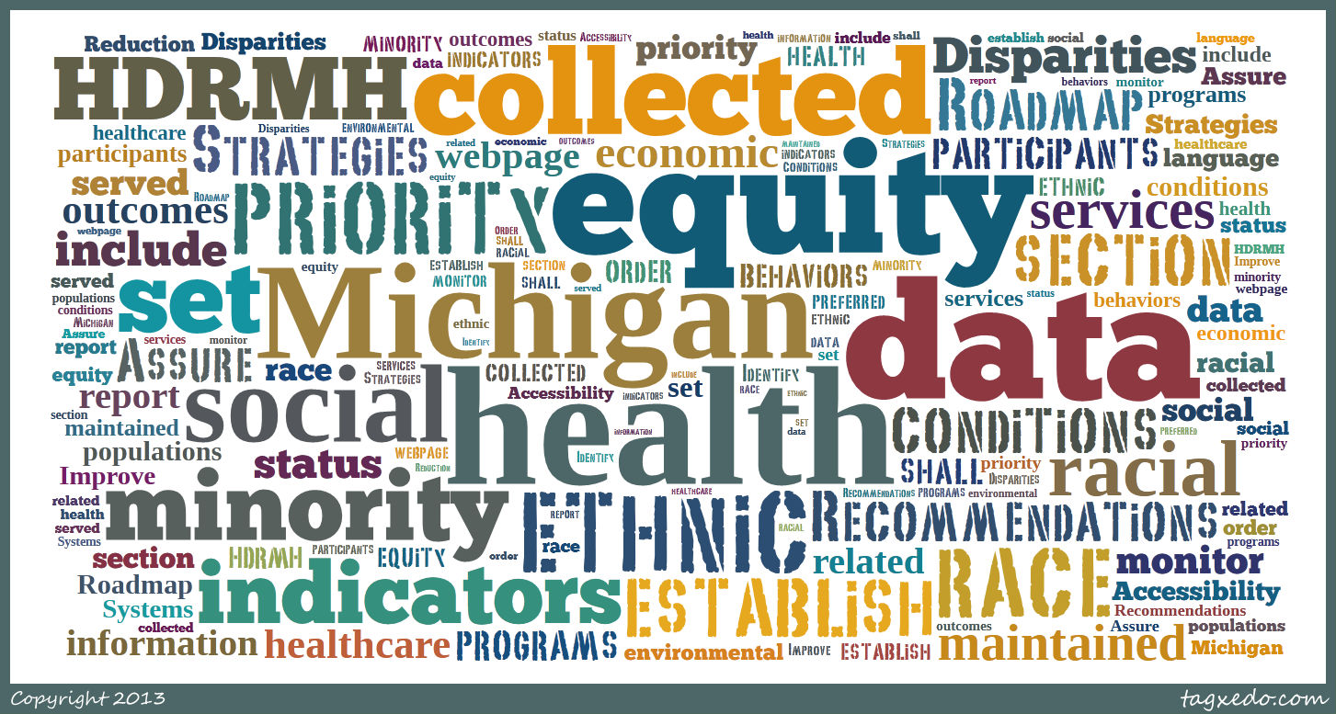
Michigan Health Equity Roadmap Recommendation #1
Michigan Health Equity Roadmap, MDHHS

Slide 4
American Community Survey
Racial/Ethnic and Ancestry Key
White alone, not Hispanic or Latino
Black alone, not Hispanic or Latino
Asian alone, not Hispanic or Latino
American Indian and Alaska Native alone or in combination with one or more other races*
Arab (all groups)*
Hispanic or Latino (of any race)
Some other race alone, not Hispanic or Latino
*Includes both Hispanic and non-Hispanic
Hispanic is an ethnicity, not a race. Persons of Hispanic ethnicity can be of any race. Persons with the same ethnicity share a common cultural and/or geographic background.
American Community Survey, U.S. Census Bureau

Slide 5
Michigan Population
White alone, not Hispanic
Black alone, not Hispanic
American Indian and Alaska/ Native alone, not Hispanic
Asian alone, not Hispanic
Some other race alone, not Hispanic
Two or more races, not Hispanic
Hispanic or Latino, of any race
Arab American Other
American Indian or Alaska Native alone or in combination with one or more other races
Other
2011-2015 American Community Survey
Notes:
Do we need the 2 side pie charts if the next slide is also included?

Slide 6
Proportion of Uni- or Multi- Racial Reported, by Race, Michigan 2011-2015
2011-2015 American Community Survey
Notes:
Wants the title to change to indicate the fact that it is a proportion of number of races reported.

Slide 7
Social Determinants of Health

Slide 8
Median Annual Household Income, Michigan 2011-2015
All Race/ Ethnicities
= $49,576
2011-2015 American Community Survey, U.S. Census Bureau

Slide 9
Percent of Female-Headed Households,
Michigan 2011-2015
All Race/ Ethnicities
= 12.7%
2011-2015 American Community Survey, U.S. Census Bureau

Slide 10
Percent of Population Living Below Federal Poverty Level, Michigan 2011-2015
All Race/
Ethnicities
= 16.7%
2011-2015 American Community Survey, U.S. Census Bureau

Slide 11
Percent of Population <18 Years Living Below Federal Poverty Level, Michigan 2011-2015
All Races/
Ethnicities
= 23.1%
2011-2015 American Community Survey, U.S. Census Bureau

Slide 12
Percent of Population <5 Years Living Below Federal Poverty Level, Michigan 2011-2015
All Race/ Ethnicities
= 27.1%
2011-2015 American Community Survey, U.S. Census Bureau

Slide 13
Percent of Civilian Labor Force that is Unemployed, Michigan 2011-2015
All Race/ Ethnicities
=6.0%
2011-2015 American Community Survey, U.S. Census Bureau

Slide 14
Percent of Population ≥25 Years with Less than a High School Diploma, Michigan 2011-2015
All Race/ Ethnicities
= 10.4%
2011-2015 American Community Survey, U.S. Census Bureau

Slide 15
Percent of Population >25 Years with Less than a Bachelor’s Degree, Michigan 2011-2015
All Race/ Ethnicities
= 73.0%
2011-2015 American Community Survey, U.S. Census Bureau

Slide 16
Percent of Renters Paying >30% of Income on Rent, Michigan 2011-2015
All Race/ Ethnicities
= 48.5%
2011-2015 American Community Survey, U.S. Census Bureau

Slide 17
Percent of Population Speaking English Less than “Very Well”, Michigan 2011-2015
All Race/ Ethnicities
= 3.3%
2011-2015 American Community Survey, U.S. Census Bureau

Slide 18
Percent Not Living in Owner-Occupied Housing,
Michigan 2011-2015
All Race/ Ethnicities
= 26.8%
2011-2015 American Community Survey, U.S. Census Bureau

Slide 19
Percent Households With No Vehicle Available for Use, Michigan 2011-2015
All Race/ Ethnicities
= 8.0%
2011-2015 American Community Survey, U.S. Census Bureau

Slide 20
Percent Living in Different House than Last Year,
Michigan 2011-2015
All Race/ Ethnicities
= 14.7%
2011-2015 American Community Survey, U.S. Census Bureau

Slide 21
Health Status

Slide 22
Michigan Behavioral Risk Factor Survey
Racial/Ethnic and Ancestry Key
White, non-Hispanic
Black, non-Hispanic
Asian/Pacific Islander, non-Hispanic
American Indian/Alaska Native, non-Hispanic
Arab, non-Hispanic
Hispanic
Other, non-Hispanic
Michigan Behavioral Risk Factor Survey, MDHHS

Slide 23
Self-Reported Health Status is Fair or Poor, age-adjusted, Michigan 2014-2016
All Race/ Ethnicities
= 16.7%
2014-2016 Michigan Behavioral Risk Factor Survey, MDHHS

Slide 24
Percent with ≥14 Unhealthy Physical Days in Past Month, age-adjusted, Michigan 2014-2016
All Race/ Ethnicities
= 16.9%
2014-2016 Michigan Behavioral Risk Factor Survey, MDHHS

Slide 25
Percent with ≥14 Unhealthy Mental Days in Past Month, age-adjusted, Michigan 2014-2016
All Race/ Ethnicities
= 17.7%
2014-2016 Michigan Behavioral Risk Factor Survey, MDHHS

Slide 26
Obesity Prevalence, age-adjusted,
Michigan 2014-2016
All Race/ Ethnicities
= 31.5%
2014-2016 Michigan Behavioral Risk Factor Survey, MDHHS

Slide 27
Health Behaviors

Slide 28
No Leisure Time Physical Activity, age-adjusted,
Michigan 2014-2016
All Race/ Ethnicities
= 24.4%
2014-2016 Michigan Behavioral Risk Factor Survey, MDHHS

Slide 29
Prevalence of Current Smoking, age-adjusted,
Michigan 2014-2016
All Race/ Ethnicities
= 21.9%
2014-2016 Michigan Behavioral Risk Factor Survey, MDHHS

Slide 30
Prevalence of Binge Drinking, age-adjusted,
Michigan 2014-2016
All Race/ Ethnicities
= 20.2%
2014-2016 Michigan Behavioral Risk Factor Survey, MDHHS

Slide 31
Health Care

Slide 32
No Health Care Coverage Among 18-64 Year Olds, age-adjusted, Michigan 2014-2016
All Race/ Ethnicities
= 13.3%
2014-2016 Michigan Behavioral Risk Factor Survey, MDHHS

Slide 33
No Health Care Access in Past 12 Months due to Cost, age-adjusted, Michigan 2014-2016
All Race/ Ethnicities
= 14.1%
2014-2016 Michigan Behavioral Risk Factor Survey, MDHHS

Slide 34
No Routine Check-Up in Past Year, age-adjusted, Michigan 2014-2016
All Race/ Ethnicities
= 29.5%
2014-2016 Michigan Behavioral Risk Factor Survey, MDHHS

Slide 35
No Dental Visit in Past Year, age-adjusted,
Michigan 2014-2016
All Race/ Ethnicities
= 31.3%
2014-2016 Michigan Behavioral Risk Factor Survey, MDHHS

Slide 36
Chronic Disease

Slide 37
Ever toldª Asthma, age-adjusted, Michigan 2014-2016
All Race/ Ethnicities
= 16.0%
ª ever told refers to having ever been told by a doctor or other health professional
2014-2016 Michigan Behavioral Risk Factor Survey, MDHHS

Slide 38
Ever toldª Diabetes, age-adjusted, Michigan 2014-2016
All Race/ Ethnicities
= 9.4%
ª ever told refers to having ever been told by a doctor or other health professional
2014-2016 Michigan Behavioral Risk Factor Survey, MDHHS

Slide 39
Ever toldª Cancer, age-adjusted, Michigan 2014-2016
All Race/ Ethnicities
= 10.7%
ª ever told refers to having ever been told by a doctor or other health professional
2014-2016 Michigan Behavioral Risk Factor Survey, MDHHS

Slide 40
Ever toldª Chronic Obstructive Pulmonary Disease, age-adjusted, Michigan 2014-2016
All Race/ Ethnicities
=7.7%
ª ever told refers to having ever been told by a doctor or other health professional
2014-2016 Michigan Behavioral Risk Factor Survey, MDHHS

Slide 41
Ever toldª Arthritis, age-adjusted, Michigan 2014-2016
All Race/ Ethnicities
= 28.2%
ª ever told refers to having ever been told by a doctor or other health professional
2014-2016 Michigan Behavioral Risk Factor Survey, MDHHS

Slide 42
Ever toldª Cardiovascular Disease, age-adjusted,
Michigan 2014-2016
All Race/ Ethnicities
= 8.4%
ª ever told refers to having ever been told by a doctor or other health professional
2014-2016 Michigan Behavioral Risk Factor Survey, MDHHS

Slide 43
Ever toldª Depression, age-adjusted, Michigan 2014-2016
All Race/ Ethnicities
= 21.0%
ª ever told refers to having ever been told by a doctor or other health professional
2014-2016 Michigan Behavioral Risk Factor Survey, MDHHS

Slide 44
Disabilityª, age-adjusted, Michigan 2014-2016
All Race/ Ethnicities
= 24.0%
ª Proportion reported being limited in any activities because of physical, mental, or emotion problems, or reported that they required use of special equipment due to a health problem.
2014-2016 Michigan Behavioral Risk Factor Survey, MDHHS

Slide 45
All-Cancer Incidence Rate (per 100,000), age-adjusted, Michigan 2013-2015
All Race/ Ethnicities
= 446.5
2013-2015 Michigan Resident Cancer Incidence File, MDHHS

Slide 46
HIV Prevalence, Michigan 2016
Reported number of cases per 100,000 people.
All Race/ Ethnicities
= 157.4
2016 Epidemiologic Profile of HIV in Michigan, MDHHS

Slide 47
Mortality

Slide 48
Michigan Resident Death and Birth File Racial/Ethnic and Ancestry Key
White*
Black*
Asian/Pacific Islander*
American Indian/Alaska Native*
Arab*
Hispanic
*Includes both Hispanic and non-Hispanic
Michigan Resident Death Files, MDHHS

Slide 49
All-Cause Mortality Rate (per 100,000), age-adjusted, Michigan 2012-2016
All Race/ Ethnicities
= 782.0
2012-2016 Michigan Resident Death Files, MDHHS

Slide 50
Heart Disease Mortality Rate (per 100,000), age-adjusted, Michigan 2012-2016
All Race/ Ethnicities
= 199.3
2012-2016 Michigan Resident Death Files, MDHHS

Slide 51
Stroke Mortality Rate (per 100,000), age-adjusted, Michigan 2012-2016
All Race/ Ethnicities
= 37.5
2012-2016 Michigan Resident Death Files, MDHHS

Slide 52
Diabetes Mortality Rate (per 100,000), age-adjusted, Michigan 2012-2016
All Race/ Ethnicities
= 22.9
2012-2016 Michigan Resident Death Files, MDHHS

Slide 53
All-Cancer Mortality Rate (per 100,000), age-adjusted, Michigan 2012-2016
All Race/ Ethnicities
= 170.6
2012-2016 Michigan Resident Death Files, MDHHS

Slide 54
Chronic Liver Disease Mortality Rate (per 100,000), age-adjusted, Michigan 2012-2016
All Race/ Ethnicities
= 10.1
2012-2016 Michigan Resident Death Files, MDHHS

Slide 55
Kidney Disease Mortality Rate (per 100,000), age-adjusted, Michigan 2012-2016
All Race/ Ethnicities
= 14.5
2012-2016 Michigan Resident Death Files, MDHHS

Slide 56
Chronic Lower Respiratory Disease Mortality Rate
(per 100,000), age-adjusted, Michigan 2012-2016
All Race/ Ethnicities
= 45.6
2012-2016 Michigan Resident Death Files, MDHHS

Slide 57
Alzheimer’s Disease Mortality Rate (per 100,000), age-adjusted, Michigan 2012-2016
All Race/ Ethnicities
= 28.6
2012-2016 Michigan Resident Death Files, MDHHS

Slide 58
AIDS Mortality Rate (per 100,000), age-adjusted, Michigan 2012-2016
All Race/ Ethnicities
= 1.1
2012-2016 Michigan Resident Death Files, MDHHS

Slide 59
Pneumonia and Influenza Mortality Rate (per 100,000), age-adjusted, Michigan 2012-2016
All Race/ Ethnicities
= 14.7
2012-2016 Michigan Resident Death Files, MDHHS

Slide 60
Septicemia Mortality Rate (per 100,000), age-adjusted, Michigan 2012-2016
All Race/ Ethnicities
= 10.1
2012-2016 Michigan Resident Death Files, MDHHS

Slide 61
Homicide Mortality Rate (per 100,000), age-adjusted, Michigan 2012-2016
All Race/ Ethnicities
= 6.8
2012-2016 Michigan Resident Death Files, MDHHS

Slide 62
Suicide Mortality Rate (per 100,000), age-adjusted, Michigan 2012-2016
All Race/ Ethnicities
= 13.1
2012-2016 Michigan Resident Death Files, MDHHS

Slide 63
Unintentional Injury Mortality Rate (per 100,000), age-adjusted, Michigan 2012-2016
All Race/ Ethnicities
= 42.3
2012-2016 Michigan Resident Death Files, MDHHS

Slide 64
Infant Mortality Rate (per 1,000 Live Births),
Michigan 2012-2016
All Race/ Ethnicities
= 6.8
2012-2016 Michigan Resident Birth and Death Files, MDHHS

Slide 65
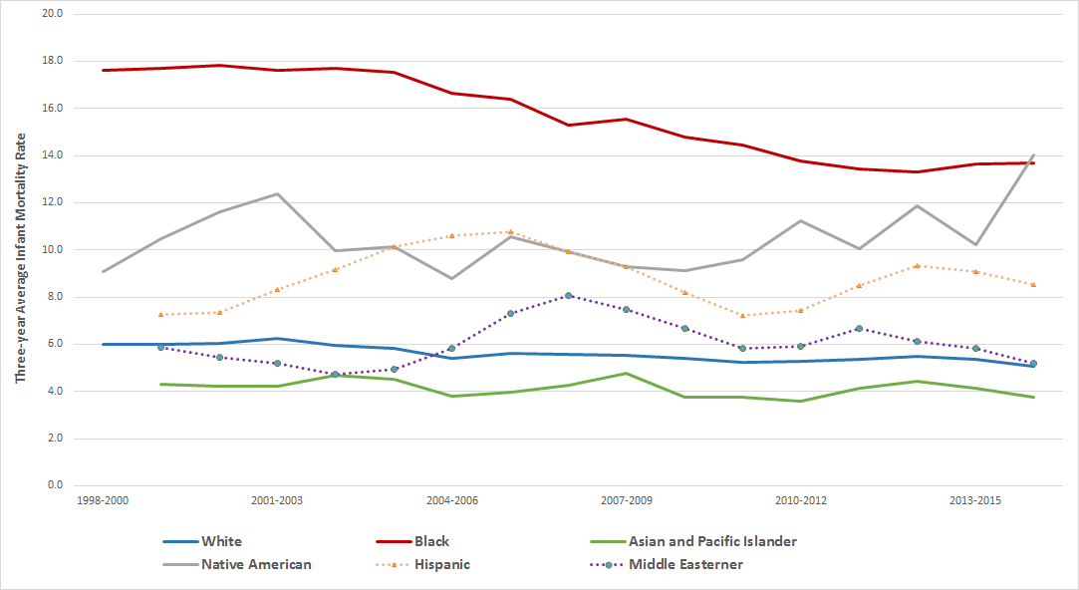
Infant Mortality Rate, per 1,000 Live Births,
Michigan 1998-2016
Infant Mortality Rate, per 1,000 Live Births, All Race/ Ethnicities
Year | Rate
1998-2000 | 8.1
2001-2003 | 8.2
2004-2006 | 7.6
2007-2009 | 7.6
2010-2012 | 6.9
2013-2015 | 6.9
1998-2016 Division for Vital Records and Health Statistics, MDHHS

Slide 66
Life Expectancy at Birth, Michigan 2000-2016
2000-2016 Division for Vital Records and Health Statistics, MDHHS

