Slide 1
Winter
North
White
West
Black
Yellow
East
Fall
Red
Spring
South
Summer

Slide 2
Air
North
White
West
Black
Yellow
East
Water
Red
Fire
South
Earth

Slide 4
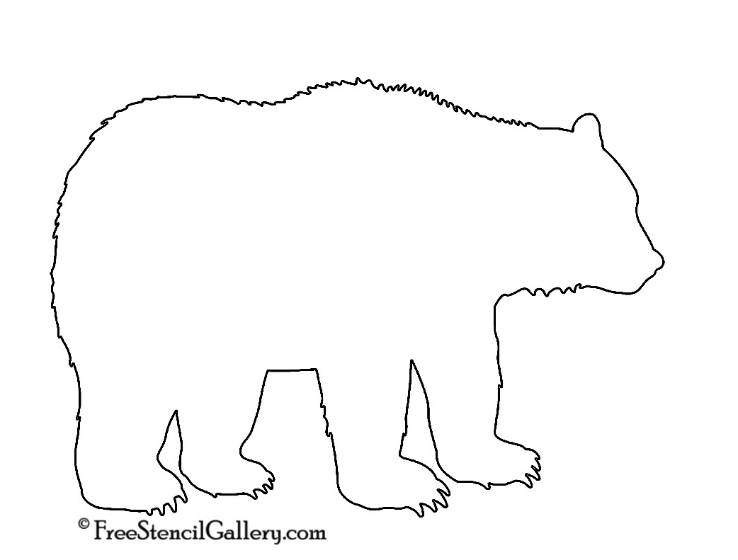
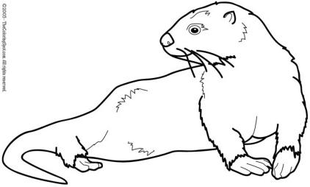
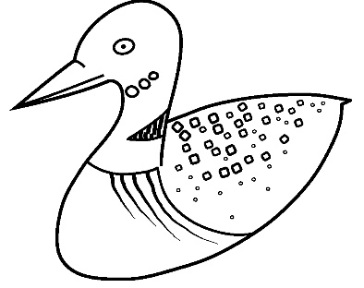
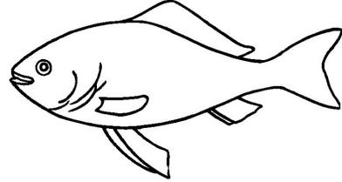
North
Bear
Otter
Loon
West
not
East
Fish
South

